Slide 1
Microsoft Azure The cloud platform for digital transformation
Kevin Harris
Azure GBB TSP for CAD
Microsoft
Notes:
(Introductions and set expectations that this presentation is designed to discuss the role of Azure as the cloud computing platform for a business’s digital transformation.)

Slide 2
Engage your customers
Transform your products
Digital transformation
Empower your employees
Optimize your operations
Notes:
Technology is omnipresent. It’s shaping how businesses plan for innovation and growth within their markets. The importance of digital transformation is urgent; Since 2000, 52% of Fortune 500 companies are gone due to digital disruption.
We see companies responding by creating digital strategies across four core areas: engaging their customers, empowering their employees, optimizing their operations, and transforming their products.
Everyone is aware of how important this is. Look at a company like Uber for example. They’ve created a digital model for the taxi industry that has allowed them to surpass every other taxi company by double or more, recently valued at $62.5 Billion. They’ve created a significant shift in an industry that has been largely untouched for decades.

Slide 3


GOING DIGITAL
1 million/hour
new devices coming online
by 2020
12 years
average age of S&P 500 corporations
by 2020
60% computing
in the public cloud by 2025
Notes:
Why is this transformation important? Let’s take a look at the next few years before us…
In 2020, 1 million new devices are expected to come online every hour. The connectivity between people and data is creating billions of new relationships that are driven not only by data but by algorithms that keep customers engaged and buying.*
In 2020, the average age of a S&P 500 corporation is expected to be 12 years old. Compare that to the S&P 500 in 1960 when the average age was 60 years old.**
By the year 2025, at least 60 percent of computing will be cloud-based, due to “everything-as-a-service” shifting fundamental changes in the IT industry.***
For digital transformation, mobility is the universal catalyst and cloud is the great enabler.
How are you planning for digital transformation? Do you have the right people and the right technology in place to build your digital vision?
How can you use technology to shape your future?
*http://www.gartner.com/newsroom/id/3142917
**http://upstart.bizjournals.com/resources/author/2015/06/04/fortune-500-must-disrupt-or-die-writes-r-ray-wang.html?page=all
***http://www.emersonnetworkpower.com/en-US/Latest-Thinking/Data-Center-2025/Documents/002401_DataCenter2025Report_HR_INTERACTIVE.PDF

Slide 4
Application innovation
Accelerate innovation with the cloud
Data and intelligence
Power decisions & apps with insights
Microsoft Azure
Openness and flexibility
Build freely, deploy anywhere
Trust
Protect your business
Notes:
Microsoft Azure is our cloud platform for digital transformation across your business. Our strategy to this end is to provide a platform of technologies that:
1. Accelerates app innovation through rapid app development and agility in the cloud.
2. Delivers integrated data and intelligence—data for rich insights to intelligence embedded within apps.
3. Is open and flexible, where you can use the tools and technologies you already have and want to use.
4. Is trusted to protect your business assets. As more customers expect digital experiences, they expect the data they share with an organization to be protected. We help you do that.
Let’s discuss these areas in more detail.

Slide 5
Application innovation Accelerate innovation with the cloud
Build apps faster and easier
Manage applications proactively
Deliver native mobile apps seamlessly
Notes:
With Azure, we’re providing the building blocks to help you take full advantage of the cloud, across existing teams and skillsets. We provide the platform services for rapid application development, deployment, and management.
Let’s look at some examples of how we’re delivering on our platform strategy.

Slide 6
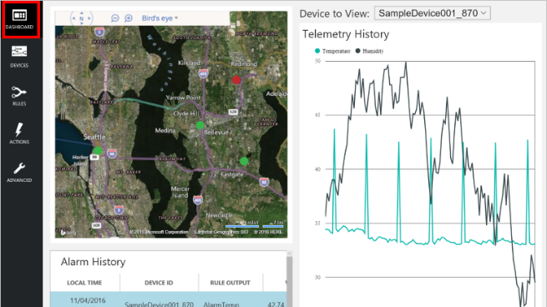
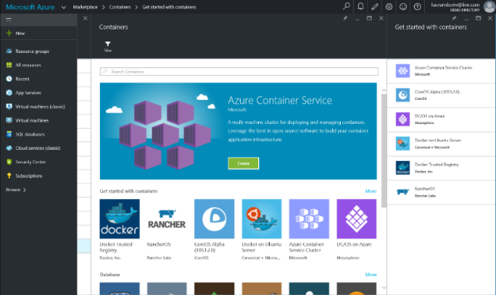
Build apps faster and easier
Build on PaaS
Azure
Internet of Things
Azure Marketplace
Existing frameworks
Web and mobile
Microservices
Serverless Compute
Build on IaaS
Virtual machines
Storage
Networking
Notes:
Building apps faster and easier means using the right building blocks for the job.
Starting from the bottom left, our core building blocks are storage, computing, and networking, or Infrastructure-as-a-Service, which provides customers with agility and cost savings.
When you add our integrated platform services, which run IaaS on the back-end, customers accelerate that agility. A recent study showed that customers using our platform as a service for app dev estimate 466% ROI than on just IaaS alone. This includes services across apps both small and internet-scale, data, integration, and so on.
In the middle, we’re packaging up services and capabilities to deliver preconfigured solutions such as with Azure IoT Suite. IoT is not a new concept in our industry, but it is extraordinarily difficult to deliver and maintain. In the past several years, the technology required to facilitate IoT solutions has improved dramatically, making it more accessible across industries and scenarios. Our IoT preconfigured solutions aim to further amplify that momentum, allowing companies to get to a working proof of concept in a fraction of the time than if they were building with individual components from scratch.
Finally, you can leverage full templates for web, mobile, containers, etc.--both first and third party--to get started in minutes rather than hours and days, through the Azure Marketplace. The screenshot here is our gallery of container templates, ranging from Docker to Mesosphere.

Slide 7
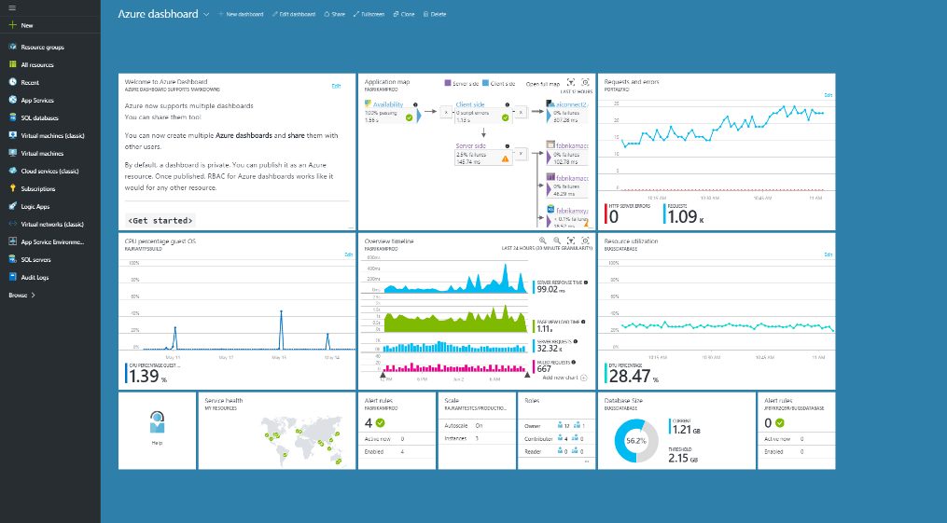

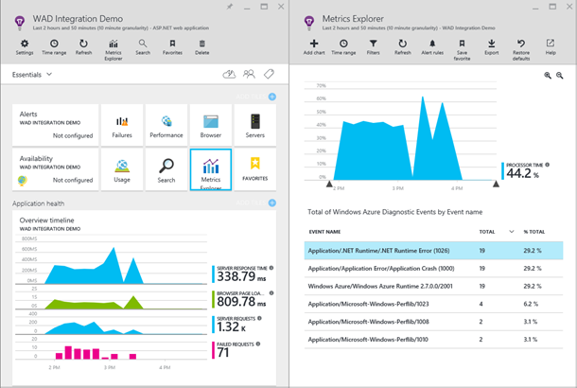
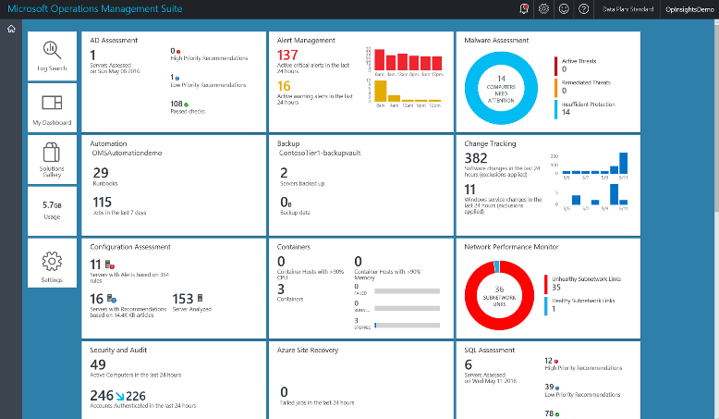
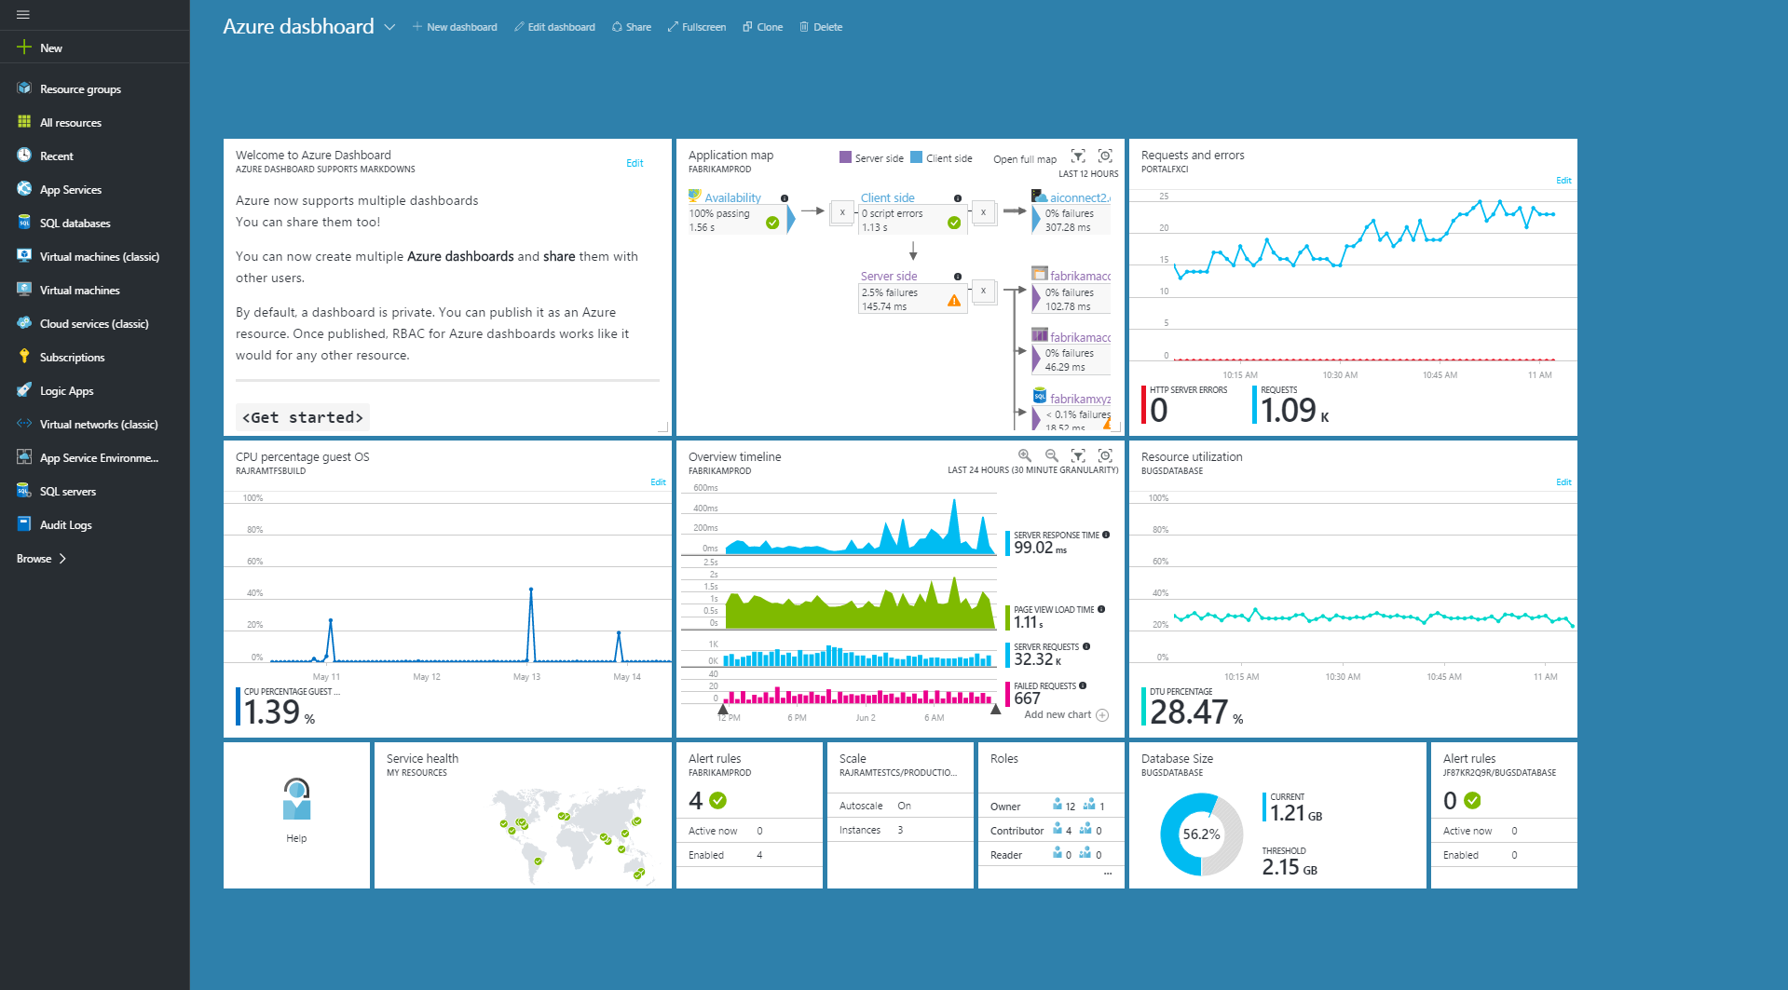
Manage applications proactively
Azure Portal
Application Insights
Operations Management Suite
Notes:
Coupled with cloud speed and agility, you need insights and actions to quickly monitor, iterate, and manage your systems. Azure services, dev tools, and hybrid capabilities provide you the ability to track 360-degree health of your systems.
To begin, on the left we have the Azure Portal. When you sign up for Azure you get the ability to build dashboards that include monitoring, metrics for individual resources, topology views, and more—this is something each user can personally configure.
When building applications, many groups leverage Application Insights for monitoring within the DevOps process. Application Insights integrates with the Azure portal to view metrics directly from applications, as well as application dependencies.
Finally, on the right, Operations Management Suite pulls together cloud, on-premises, and multi-cloud into one view for management as well as security across Azure, but also AWS, Windows Server, Linux, VMWare, OpenStack, etc.

Slide 8

Deliver native mobile apps seamlessly
Mobile DevOps
Mobile Back-end Services
Code Repository
Build + Deploy
Automated Testing
User Testing
Cloud and Offline Data
User Authentication
Backlog
Push Notifications
Monitor and improve
Notes:
Remember our earlier statistic that by 2020, the number of mobile devices coming online will reach 1 million per hour? Mobile development couldn’t be a more important response to targeting customers and providing connected experiences across different interaction points.
That’s why we’ve been investing in mobile capabilities to help customers build mobile apps fast across platforms, with continuous integration and continuous deliver.
On the front-end of development, Xamarin helps developer productivity for building mobile apps with C# compiling code across platforms: iOS, Android, Microsoft. Xamarin Test Cloud, provides automated testing to find bugs quickly before you deploy.
With HockeyApp we can manage beta distribution, get real-time crash reports, and engage with customer feedback for continuous integration.
Azure Mobile App Service provides the back-end services that customers require, including offline data sync, user authentication, and push notifications. Mobile App Service is also tool agnostic, so whether you’re using Xamarin/HockeyApp or another tool, you can leverage the mobile back-end services all the same.

Slide 9

Application innovation
Notes:
Heineken
Customer profile: HEINEKEN, which sells its flagship premium beer in 178 countries, has long run innovative marketing campaigns around the world. Along with great beer, it’s part of what makes Heineken one of the world’s best-known brands. http://www.heineken.com
Challenge: HEINEKEN based a global campaign on UEFA Champions League (UCL) soccer games. The campaign would launch simultaneously in more than 70 markets and 30 languages, and would require real-time computing on a global scale. That’s because the centerpiece of the UCL campaign was a pinball game for consumers to play live against players anywhere in the world. The solution would also have to support multiple leaderboards for each player, based on the number of friends and family that an individual played with. It would require real-time updating of the leaderboards as play was underway. HEINEKEN wanted the technology to support 1 million simultaneous users.
Strategy: To meet these requirements, HEINEKEN expanded its use of Azure from one datacenter to four—one each in Europe and Asia, and two in the US—gaining geo-redundancy and low latency. Data was stored in Azure Table Storage for asynchronous updates. The storage was structured with 10,000 partitions—up from 10 initially—for the requisite scalability. HEINEKEN developed the solution using Microsoft Visual Studio 2013. The architecture was tested with a Visual Studio load-testing cluster to generate the load and test the application without testing the Internet. Microsoft Services consultants helped develop and load-test the solution, and resolve performance issues.
Results: HEINEKEN used Microsoft Azure to achieve 100 percent reliability on a massive scale. The platform exceeded its service-level agreement with perfect performance in the UCL campaign, supporting 2 million gameplays per hour and with capacity for more than 40 million players in all.
Additional information:
https://customers.microsoft.com/Pages/CustomerStory.aspx?recid=17735

Slide 10
Application innovation
Accelerate innovation with the cloud
Data and intelligence
Power decisions & apps with insights
Microsoft Azure
Openness and flexibility
Build freely, deploy anywhere
Trust
Protect your business
Notes:
Let’s take a look at the next area, data and intelligence.

Slide 11
Data and intelligence Power decisions & apps with insights
Support business strategy with any data
Predict and respond proactively
Learn and engage with artificial intelligence
Notes:
Digital transformation can’t happen without data. You need the right data to derive new insights as well as to inform whether or not your digital vision is paying back on its investment. Intelligent services on Azure provide the processes and connections to create experiences that meet the demand of mobile customers.
Let’s look at some of the key benefits of Azure data and intelligence.

Slide 12
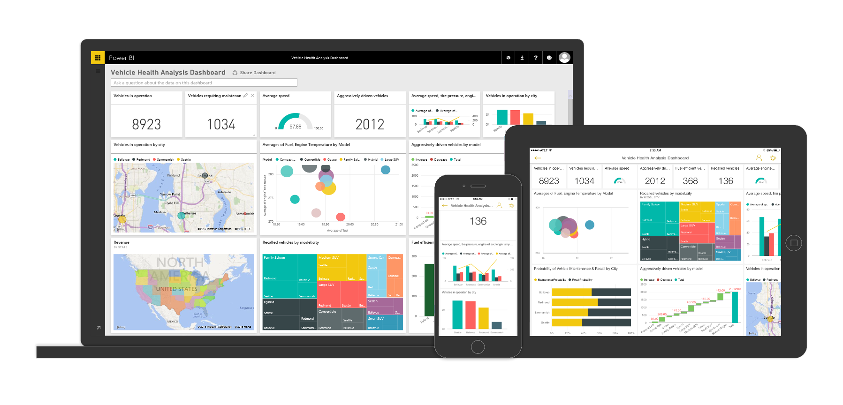
Support business strategy with any data
Back-end power
Front-end insights
Big data
Web data
Traditional data
OLTP
ERP
CRM
LOB
Notes:
Data is exploding. You have traditional data sources like ERP and CRM. You also have web data – web logs, mobility, targeted advertising, search data. And finally you have big data – data from devices, sensors, social media, content, marketplaces.
How do use this to your advantage?
Consider professional sports. Real Madrid takes their customer data in legacy systems, combines it with social data and mobile app usage data to better understand customers and target for specific marketing incentives, using Azure Data Factory which extracts, loads, and transforms the data, then uses HDInsight for querying. The data is then pushed to Azure SQL Database and consumed by Excel and Power BI.
This is true back-end power—supporting any data, with any query--to front-end insights—using natural language Q&A to query--that is directly impacting revenue for Real Madrid.

Slide 13
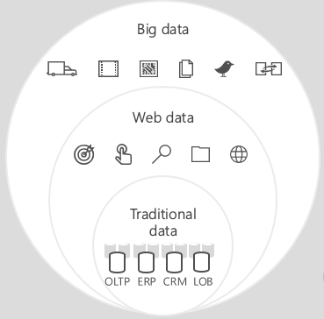
Predict and respond proactively
Azure Machine Learning templates
Azure Machine Learning service
Demand forecasting
Predictive maintenance
Vehicle telemetry
Data
Modeling & APIs
Clients
ML STUDIO
API
Notes:
Once you understand the data you have, data you need, and potential outcomes you may drive, you can apply intelligence with machine learning.
Machine learning refers to computing systems that become smarter with experience. Experience in this case is past data + human input. Demand forecasting for example can apply to predicting how much inventory is needed, when a person is likely to go to the hospital
On the left, some of the common use cases that we’ve built templates for are Demand Forecasting, Predictive maintenance, and vehicle telemetry. Again, this is to help you get started faster.
The illustration on the right highlights three key benefits supported with Azure Machine Learning. One problem that many enterprises face is data ingestion. With the cloud, you can bring in data sources with the ease of a drop down or drop your on-premises data set into the built in storage space. Users can then model in our development environment – Machine Learning Studio – where we’re offering R, Python and SQLite as first class citizens in addition to our world-class Microsoft algorithms.
The second issue – and often the primary one – is putting finished work into production in a way others can use. We’ve heard from many data scientists that they model in R on a Linux stack but then have to hand over their work to developers who need to translate that into another language to actually make it work. This time consuming and unnecessary process has been eliminated with our system, as the model is with a click transformed into a web service end-point that can run over any data, anywhere and connect to any solution or client.
Next, not only can this model be put into production for your company, it can be made available for the world on our Machine Learning Marketplace. Microsoft hosts your solution and markets it for you, while you have the freedom to brand and monetize as you see fit. We also offer a number of Microsoft solutions here.

Slide 14
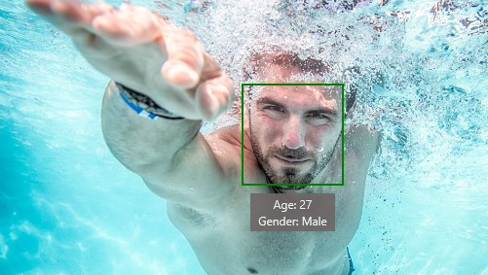
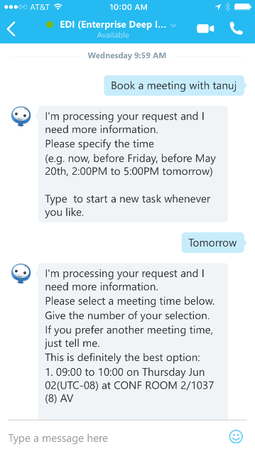
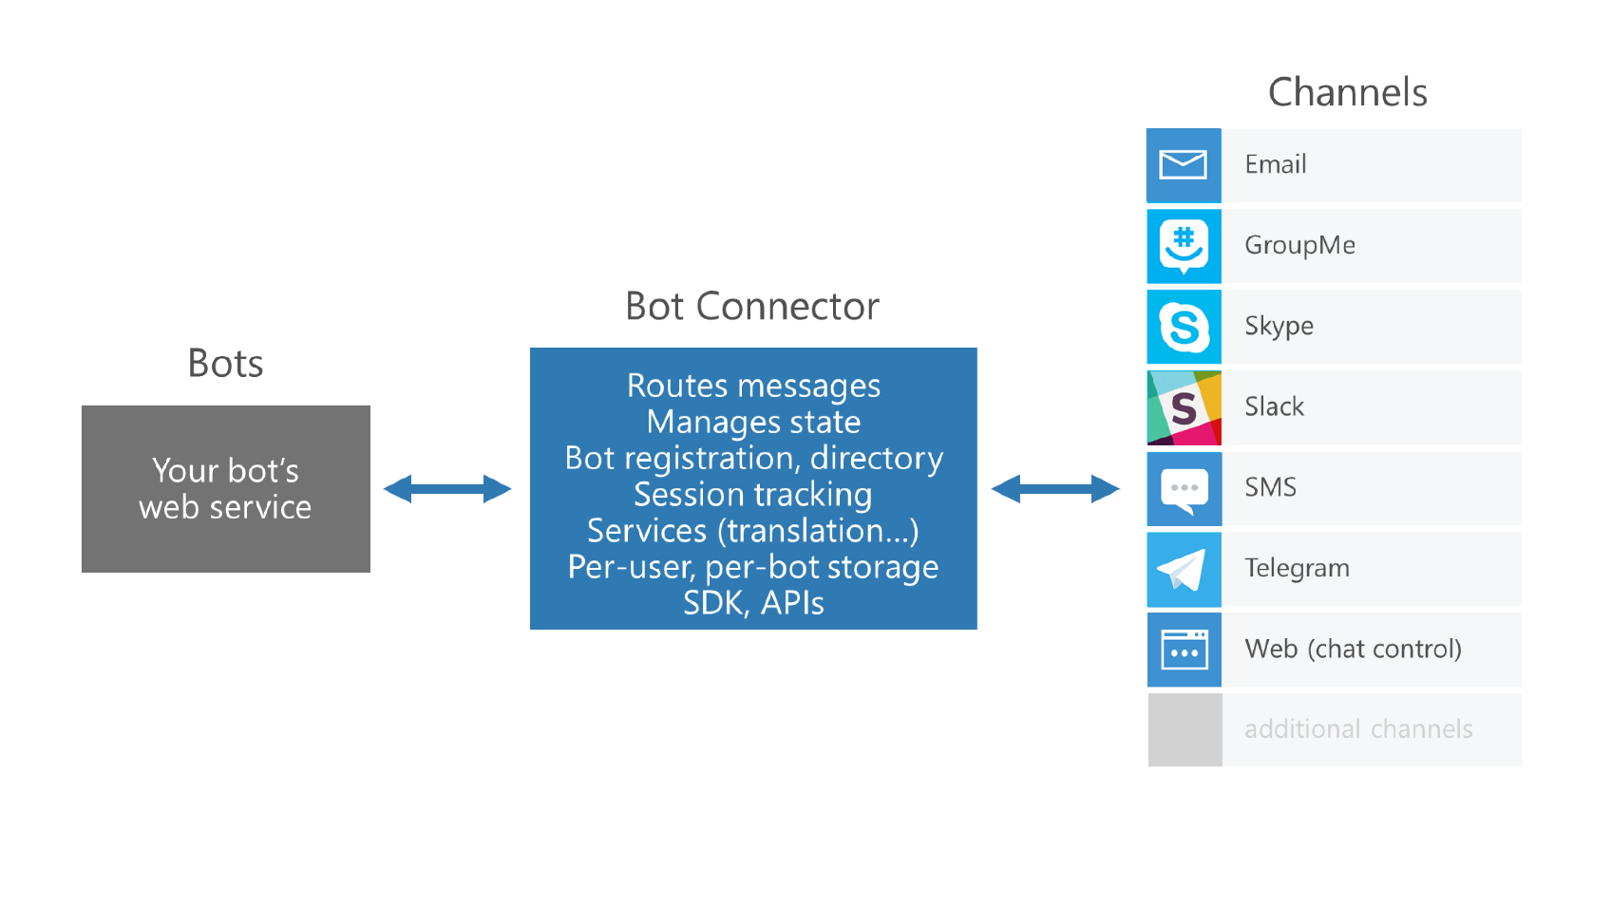



Learn and engage with artificial intelligence
Cognitive services
Bot framework
Is Adult Content: False
Categories: people_swimming
Notes:
Lastly, Azure supports a number of artificial intelligence capabilities. Artificial Intelligence is no longer an exotic concept. Rather, it’s embedded into experiences we have every day. Siri and Cortana for example help us complete tasks faster and on the go.
Another example is Dominos. They recently went through a massive digital transformation to improve their brand perception and engage customers in new ways, and they launched a series of “app-less apps” or rather social/chat/text apps where you can order pizza through natural language interaction through channels like Twitter, and SMS. Not only are they reaching people in channels unexplored by any other pizza company, they’re building a positive brand image as a company that’s truly centered on customers.
With Cognitive Services and the Bot Framework, we’re providing the APIs and SDKs to help you embed these experiences within your Azure applications.
Cognitive Services includes APIs for vision, speech, language, knowledge, and search.
Bot Framework includes a connector, to text/sms, O365, Slack, etc., an open source SDK, and a directory of public bots.

Slide 15


Data and intelligence
Notes:
Rolls Royce
Customer profile: Rolls-Royce has more than 13,000 engines for commercial aircraft in service around the world, and for the past 20 years, it has offered customers comprehensive engine maintenance services that help keep aircraft available and efficient. http://www.rolls-royce.com/
Challenge: Worldwide, flight delays and disruptions cost the airline industry millions of dollars every year. Even a small reduction in “aircraft on ground” (AOG) time can translate into significant amount of money, so airlines are always looking for ways to improve the efficiency of maintenance activities.
The same applies to fuel costs. Fuel generally accounts for a whopping 40 percent of airlines’ operating expenses. Even a 1 percent optimization of fuel consumption can save an airline millions of dollars annually.
Strategy: Starting with Azure IoT Suite, Rolls-Royce will be able to collect and aggregate data from disparate and geographically distributed sources at an unprecedented scale.
Using Microsoft Cortana Intelligence Suite, Rolls-Royce will be able to analyze a rich set of data and perform data modeling at scale to accurately detect operational anomalies and help customers plan relevant actions.
Results: Rolls-Royce foresees that by gaining access to wider sets of operational data, it will be able to offer more valuable services to customers. Another important benefit is that the company will gain a better understanding of how it should structure its support contracts, how it can better manage risk, and what its product development needs are.
Additional information:
https://customers.microsoft.com/Pages/CustomerStory.aspx?recid=26536

Slide 16
Application innovation
Accelerate innovation with the cloud
Data and intelligence
Power decisions & apps with insights
Microsoft Azure
Openness and flexibility
Build freely, deploy anywhere
Trust
Protect your business
Notes:
Let’s take a look at the next area. Azure provides the openness and flexibility to build freely and deploy anywhere.

Slide 17
Openness and flexibility Build freely, deploy anywhere
Build and run open source solutions
Extend on-premises data and apps
Deploy the cloud on-premises
Notes:
With Azure, we strive to meet customers where they are with what they have today. We do this in two ways: By providing the openness to build freely, and flexibility to deploy how and where you need to.

Slide 18

























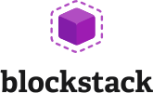



Build and run open source solutions
Any tool, application, framework
Applications
DevOps
Frameworks
Databases & middleware
Containers
Infrastructure
Notes:
We’re heavily invested in open-source technologies and partnerships, as evidenced on this slide. Nearly one in three Azure virtual machines are now running Linux, and we support Linux as a first class citizen.
Why is this important to Microsoft? Because it’s in the best interest of our customers. In fact, over 40% of CIOs are using open source as their primary strategy heading into 2017. We support our customers’ computing, whatever it is and wherever it is.
Finally, we contribute to the open source community as well as build some of our services on open source technology, like HDInsight and Azure Container Service. This also helps us scale to our customers’ needs as we rapidly release cloud solutions.

Slide 19
Extend on-premises data and apps
Hybrid Use Cases
Seamless & secure across:
Application Availability
Bottomless Storage
Identity Management
Full hybrid applications
INFRASTRUCTURE
Azure Backup
Azure Site Recovery
DATA
Azure StorSimple
SQL Server Stretch DB
USERS
Azure Active Directory
APPS
App Service
Web | Mobile | Logic Apps | API Apps
MANAGEMENT
Operations Management Suite
Notes:
With Azure, you can take the investments you’ve made in data and intellectual property, and extend from on-premises to the cloud, or vice versa. Azure provides the portability to move your technology investments, whether open source or not, from cloud to on-premises and vice versa.
Companies fall into two main buckets with regards to hybrid: those who are using hybrid solutions as a temporary bridge to the cloud, and companies who are architecting hybrid solutions for use in perpetuity.
Amongst each of these types of customers, there are common use cases such as:
Application Availability
Bottomless Storage
Identity Management
Full hybrid applications
We provide seamless, secure hybrid cloud capabilities across infrastructure, data, users, apps, and management.

Slide 20
Deploy the cloud on-premises
Azure Stack
Portal | PowerShell | Dev-ops tools
Portal | PowerShell | Dev-ops tools
One Azure ecosystem
Azure Resource Manager
Azure Resource Manager
Unified app development
Azure IaaS | Azure PaaS
Azure IaaS | Azure PaaS
Compute | Networking | Storage
App Service | Service Fabric
Azure services in your datacenter
Cloud infrastructure
Cloud-inspired infrastructure
Microsoft Azure
PUBLIC
Microsoft Azure Stack
PRIVATE | HOSTED
Notes:
Azure Stack provides the capabilities of Azure for customers who want to host it on their own premises. The Azure portal acts as a hub for managing between cloud and on-premises.
On the left hand side, you have Microsoft Azure as a public cloud offering. Note that on the right, with Azure stack, the parity between key elements:
Portal | PowerShell | Dev-ops tools provide the same end user experiences and same app model.
Azure Resource Manager lets you build reusable application templates for traditional and cloud-native apps.
Azure IaaS and PaaS services are available in both for unified app dev.
On the infrastructure layer, we are making some translation – Azure runs on hyper-scale (each scale unit is 20 racks!) while you folks likely run a lesser footprint. So we’re doing some work to make this fit into your environments.
This provides some key benefits across roles:
Application developers can maximize their productivity using a ‘write once, deploy to Azure or Azure Stack’ approach. Using APIs that are identical to Microsoft Azure, they can create applications based on open source or .NET technology that can easily run on-premises or in the public cloud. They can also leverage the rich Azure ecosystem to jumpstart their Azure Stack development efforts.
IT professionals can help transform on-premises datacenter resources into Azure-consistent IaaS and PaaS services, thereby maximizing agility and efficiency. End users can quickly provision services using the same self-service experience as Azure. IT gets to use the same automation tools as Azure to control the service delivery experience.
Business leaders can truly take advantage of cloud on your terms.

Slide 21

Openness and flexibility
Notes:
Siemens | Enel
Customer profile: Siemens is a global powerhouse focusing on the areas of electrification, automation and digitalization. One of the world’s largest producers of energy-efficient, resource-saving technologies, Siemens is a leading supplier of systems for power generation and transmission as well as medical diagnosis. In infrastructure and industry solutions the company plays a pioneering role. As of September 30, 2015, SIemens had around 348,000 employees in more than 200 countries. and generated revenues of €75.6 billion in 2015. http://www.siemens.com/about/en/
As a truly global business, Enel is perfectly placed to open power around the world. Enel’s global reach extends from Europe, to North America, Latin America, Africa and Asia. They connect more than 61 million customers to more reliable and increasingly sustainable power, drawing from a net installed capacity of more than 89 GW, and they run 1.9 million kilometers of grid network, supplying the largest customer base of any European energy company. http://www.enel.com
Challenge: When global technology powerhouse Siemens and multi-national power company Enel (Official Global Partner of Expo Milan 2015) joined forces to create an Energy Management System (EMS) they could showcase at Expo Milano 2015, they had the “Internet-of-Things” paradigm in mind. The solution would have meters and sensor devices sending energy, environmental and other data from the power utility Enel Supervisory Control & Data Acquisition (SCADA) smart grid to a control system in the cloud that could then report key information to energy decision-makers using mobile devices as well as desktop and laptop PCs.
Strategy: One of the key decisions the Siemens team made at the start of the project was to provide only a web application. The decision was made to build these web applications using HTML5 to provide the application not only for the external environment, but also for the mobile application. The two companies chose to work with these open source technologies because it enabled them to use a common JavaScript stack end-to-end. Plus, they could also use the same microservice architecture technology for mobile as well as cloud applications.
Results: They chose Azure because, according to Maurizio Bigoloni, Smart Grid Solutions Head of Operations, “The decision was made due to the fact that Microsoft Azure is quite open, so not only was Microsoft technology supported by Azure, but also non-Microsoft and Open Source technologies could be used. This was, for us, an important point. We needed support for JavaScript, HTML5, MongoDB on Linux, and Node.js. Microsoft Azure provided it.”
The decision, however, didn’t end there. “The most important point,” emphasizes Bigoloni, “was the support that Microsoft was able to provide. The fact that they were able to support our solution architecture and the solution design on Azure was the most crucial thing.”
Using the Microsoft Azure platform, development of the entire solution took less than a year and a half. This gave the companies plenty of time to prepare for their successful debut at Expo Milano 2015.
Additional information:
https://customers.microsoft.com/Pages/CustomerStory.aspx?recid=22171

Slide 22
Application innovation
Accelerate innovation with the cloud
Data and intelligence
Power decisions & apps with insights
Microsoft Azure
Openness and flexibility
Build freely, deploy anywhere
Trust
Protect your business

Slide 23
Trust Protect your business
Detect and mitigate threats
Achieve global scale, in local regions
Benefit from relentless business commitment
Notes:
Trust is a topic we don’t take lightly. With Azure, as well as the broader Microsoft Cloud, we safeguard data and assets in the cloud with the security, compliance, privacy, and transparency required.

Slide 24
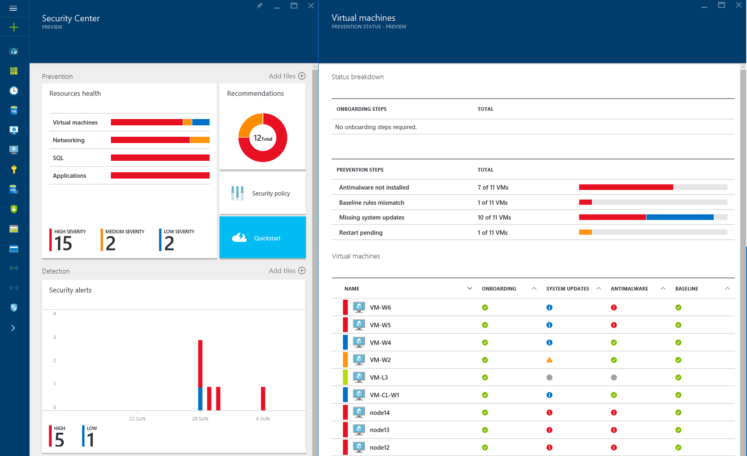
Detect and mitigate threats
Securing the platform
Empowering you
RED TEAM
BLUE TEAM
Notes:
Security is built into the services we provide to our customers, and embedded within our development processes, infrastructure, operations, and compliance.
Assume Breach is an example of operational innovation for securing your business. It is unique to Microsoft, and is a key operational practice that it uses to harden its cloud services. Here’s how it works:
The red team simulates real-world attacks at the network, platform, and application layers.
The blue team detects, protect against, and recovers.
Identifying and ejecting attackers, limiting what access an attacker would have if various layers were breached – we do this though techniques like segregation of duties, and how quickly we can restore the environment in the event of a breach. By constantly challenging the security capabilities of the service, Microsoft can stay ahead of emerging threats and be prepared to act quickly to threats.
On the right side, we provide services to empower you to protect your assets, for example,
Azure Security Center helps you prevent, detect and respond to threats with increased visibility and control over the security of all your Azure resources. It provides a central view of security across your subscriptions, and enables you to set policies and monitor security configurations. Policy-driven recommendations guide resource owners through the process of implementing security controls and enable rapid deployment of integrated Microsoft and partner security solutions. Security-related events from across your Azure deployments are automatically collected and analyzed using Microsoft global threat intelligence and expertise to identify actual threats and reduce false alarms. The resulting real-time alerts offer insights into the attack campaign and suggest ways to remediate and recover quickly.

Slide 25
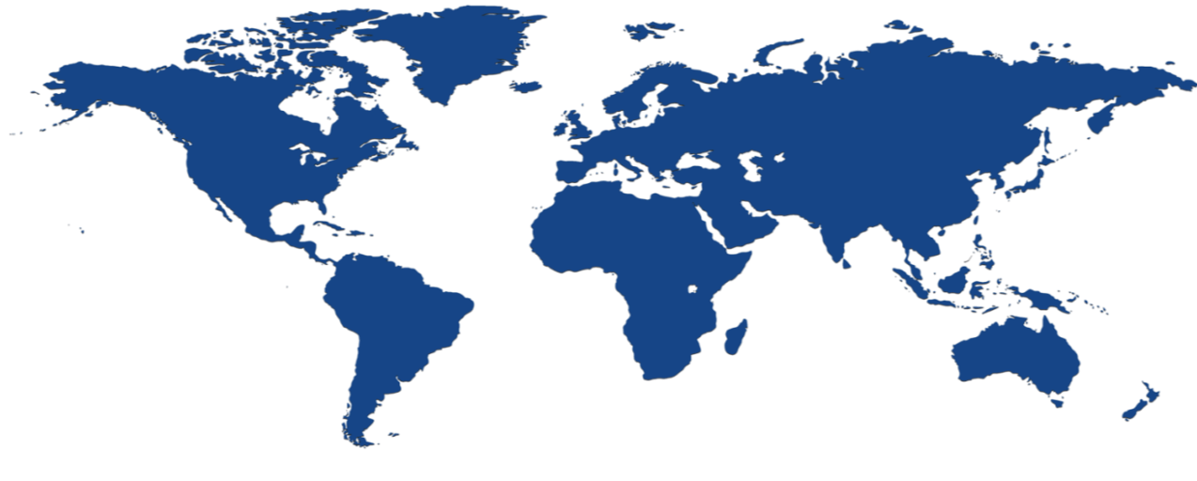


Achieve global scale, in local regions
34
regions
Notes:
The security controls we apply to development, infrastructure, operations, and compliance apply to our global customer base. Customers can explicitly choose which regions to deploy and store their data according to local privacy, security, or compliance requirements.
On this slide you can see the 34 regions where we operate (26 are active), including:
Public cloud regional datacenters with geographic diversity. Customers can deploy two identical workloads in different regions with an Active/Active failover model. This can ensure business continuity in the event of a local disaster.
Local and sovereign cloud. In-country Microsoft datacenters address data residency requirements, and we’re using a combination of technology as well as a legal framework to legally isolate certain regions of the world according to local sovereignty, governance, and rule of law, all the while providing the same exact up to date set of services in those regions.
There are four sovereign clouds today and four more planned, including Germany for example, as well as:
US Gov (2)
China North Beijing
China South Shanghai
Planned:
Germany Central
Germany Northeast
US DoD East
US DoD West

Slide 26




























Benefit from relentless business commitment
ISO 27001
SOC 1 Type 2
SOC 2 Type 2
PCI DSS Level 1
Cloud Controls Matrix
ISO 27018
Content Delivery and Security Association
Shared
Assessments
FedRAMP
JAB P-ATO
HIPAA/ HITECH
FIPS 140-2
21 CFR
Part 11
FERPA
DISA Level 2
CJIS
IRS 1075
ITAR-ready
Section 508 VPAT
European Union Model Clauses
EU Safe Harbor
United Kingdom
G-Cloud
China Multi
Layer Protection
Scheme
China
GB 18030
China
CCCPPF
Singapore
MTCS Level 3
Australia
Signals
Directorate
New
Zealand GCIO
Japan
Financial Services
ENISA
IAF
Notes:
Finally, Azure is designed with an aggressive compliance strategy that helps customers address business objectives and industry standards & regulations. Our security compliance framework includes test and audit phases, security analytics, risk management best practices, and security benchmark analysis to achieve certificates and attestations.

Slide 27
Application innovation
Accelerate innovation with the cloud
Data and intelligence
Power decisions & apps with insights
Microsoft Azure
Openness and flexibility
Build freely, deploy anywhere
Trust
Protect your business
Notes:
In summary, Microsoft Azure is the cloud platform for digital transformation, from app innovation to data and intelligence, with the openness and flexibility to deploy what you want, where you want it, with industry-leading security and compliance.

Slide 28
Momentum
120,000
New Azure customer subscriptions/month
150 billion
Azure SQL query requests processed/day
>85%
of Fortune 500 use Microsoft Cloud
715 million
Azure Active Directory users
120 billion
Hits to websites run on Azure Web App Service
Notes:
We’ve had incredible momentum in the last year with over 85% of Fortune 500 companies using the Microsoft Cloud.

Slide 29
Microsoft Cloud
Secure Productive Enterprise &
Operations Management + Security
Cortana Intelligence Suite
Office 365
Dynamics
Azure
PRODUCTIVITY
BUSINESS APPS
SECURITY & MANAGEMENT
DATA & INTELLIGENCE
APPLICATION INNOVATION
Notes:
Finally, Azure is just one component of the Microsoft Cloud. We’ve discussed integration across data and intelligence and security and management, but you also benefit from integrated solutions across productivity with Office 365, and business apps with Dynamics.

Slide 30
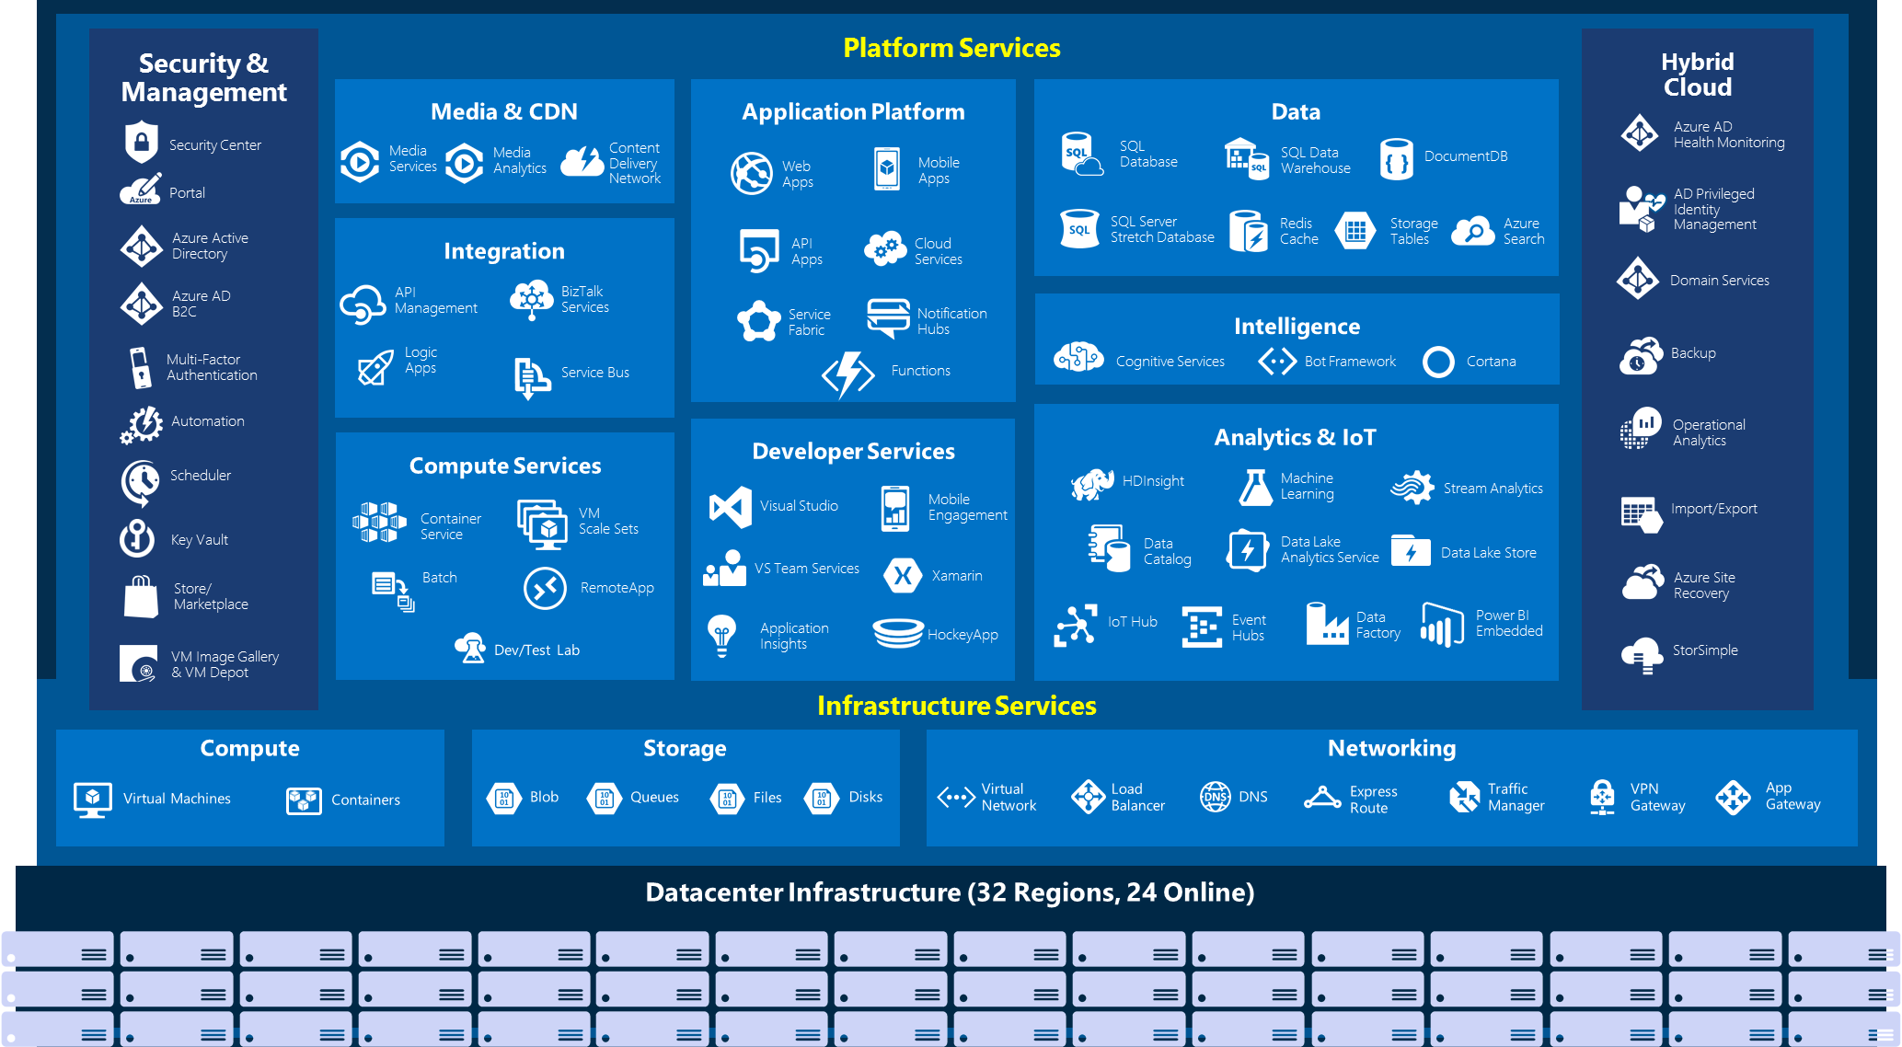
Notes:
Why this Slide:
It shows we have a very broad platform. It about BOTH IaaS and PaaS, that these work together. It shows that we continue to lead in world class IT capabilities and that there’s really nothing missing.
Key Points:
We have already seen how the Azure Platform is IaaS + Pass – but I want you to understand that this is a huge number of capabilities – IT building blocks if you will.
Every one of these blocks you provision anytime, self-service anywhere in the world 24x7. You pay for what you use, you can get more or less anytime and you can fully automate everything…
DON’T spent too much time on this slide – you are going to DEMO (aren’t you!!!)… DON’T go through each block…
Transition to NEXT Slide: Make the build go backwards to show JUST IaaS and then you will go to the demo to show it.

Slide 31
Azure Portal Demo
Notes:
We’ve gone through a journey today, through the various capabilities of Azure that support your path toward digital transformation, from app innovation, to data and intelligence, to open and flexible deployments, to trust. We’re here to partner with you as you continue to innovate and transform. Thank you.

Slide 32
Questions?
Notes:
We’ve gone through a journey today, through the various capabilities of Azure that support your path toward digital transformation, from app innovation, to data and intelligence, to open and flexible deployments, to trust. We’re here to partner with you as you continue to innovate and transform. Thank you.

Slide 33
Thank You!
Notes:
We’ve gone through a journey today, through the various capabilities of Azure that support your path toward digital transformation, from app innovation, to data and intelligence, to open and flexible deployments, to trust. We’re here to partner with you as you continue to innovate and transform. Thank you.

